Slide 1
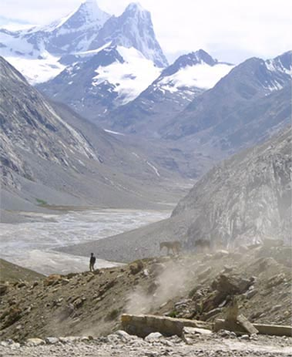
Fellowship of the Heart
Getting Started — the Four Connects, walked around the table on alternating evenings
Evening Series 2026–27 · at the Tittle home · v1.5E DRAFT
All Scripture: ESV · The Companion lesson plans carry the full scripts — these slides carry the room
1
Notes:
DECK TITLE · pre-session · DIVIDER
On screen as the room assembles on night one. All Scripture ESV; the plans carry the scripts; these slides carry the room — and these notes carry you.

Slide 2
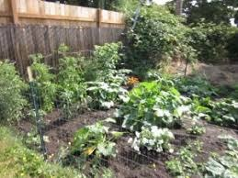
SESSION 9
The Garden of Your Heart I
An experiential encounter with Jesus in your interior space — the first guided run; a senior leads the second next week
Quarter 2: Connect with God
114
Notes:
S9 · pre-session · DIVIDER
On screen through dinner and as the circle forms. Greet at the door — the slide holds the room.

Slide 3
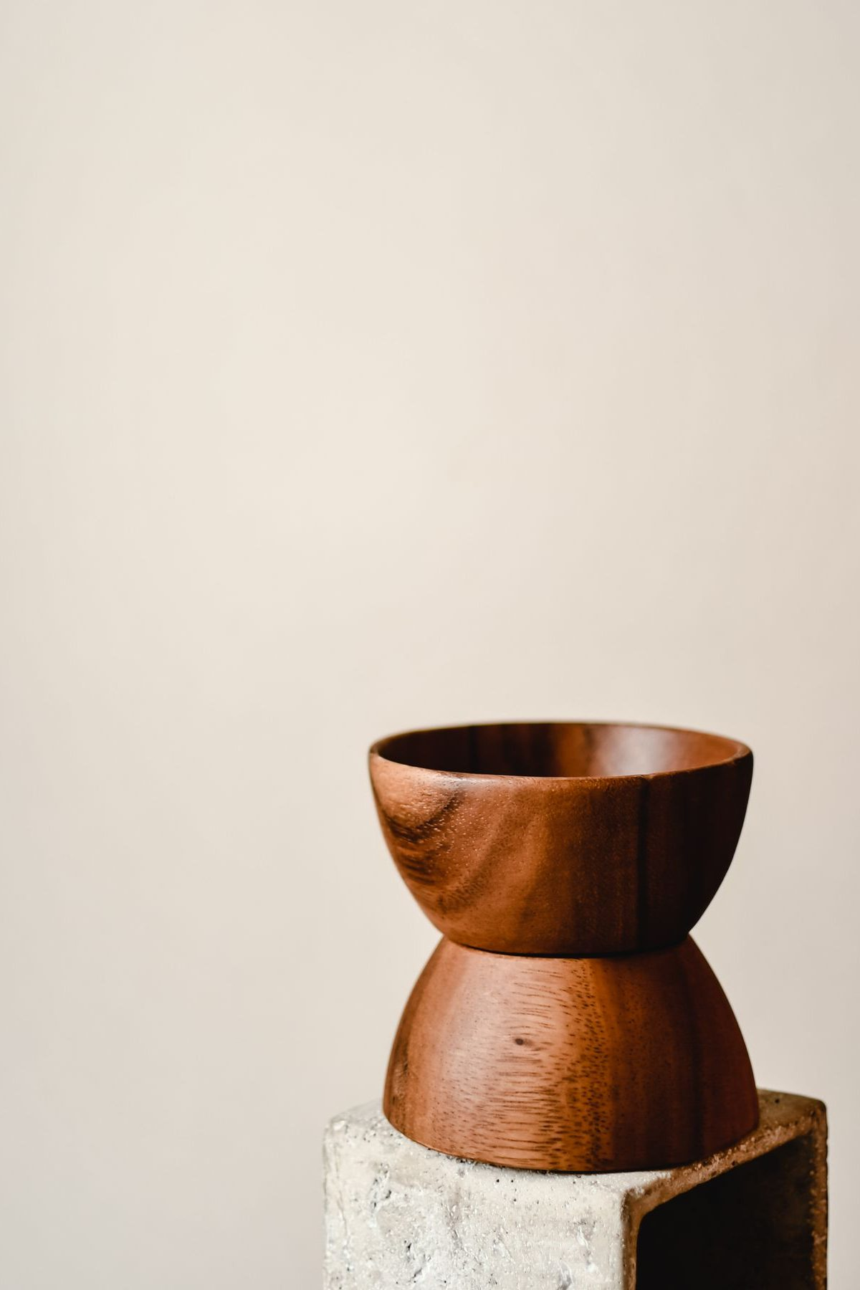
Session 9 — Tonight’s Road
1 Welcome and centering
2 Week 7 check-in
3 Scripture and framing
4 Bridge into the exercise
5 The Garden exercise — whole room, then pairs
6 Merge and one-word landing
7 Homework commissioning — handout + check-in partners
8 The Leader Feedback Round — both leaders
9 Closing container
115
Notes:
S9 · 7:00–7:08 · LEAD: CONTAINER HOLDER
BEATS: 1. Today is the quietest deep work of the series: the Garden of Your Heart — a guided imaginative prayer with the whole room, then sharing in pairs by invitation only. 2. Frame gently and do not over-explain — of all the sessions, this one has produced the most lasting fruit. 3. Nothing is required today — not even doing the exercise.
CUES: Arrival runs quieter than usual; match the tone from the door.

Slide 4
Opening Container — the Eight Steps
1 Welcome — five minutes to open the container
2 Phones silenced and put away
3 Stand in a circle
4 One-word check-in — how you actually are, right now
5 Put out / bring in — set something down; bring a blessing in
6 Spoken commitment: “I am here. I am paying attention. I am willing to be moved.”
7 Opening prayer — “Holy Spirit, you are welcome here. Speak. We are listening.”
8 Sit. Begin.
116
Notes:
S9 · 7:00–7:08 · LEAD: CONTAINER HOLDER
BEATS: 1. 'Welcome back. Find a seat.' Wait — take a longer breath than usual before the blessing. 2. Aaronic blessing. 3. Frame: today is quiet, mostly interior; deeply familiar for some, brand new for others — both are fine. 4. Container: what is said here stays here; nothing is required; listen to receive.

Slide 5

Week 7 Check-In
• “Last week we walked PROAPT — a six-step practice for hearing God in scripture.”
• “One sentence about how that practice has been?”
• A parent starts — arranged beforehand, never a cold call on a teen
• Two or three voluntary contributions; anyone may pass — kept brief, tonight’s arc needs the time
117
Notes:
S9 · 7:08–7:25 · LEAD: CONTAINER HOLDER
BEATS: 1. One sentence each on how the daily PROAPT practice has been. 2. Take 2–3 voluntary contributions and keep it brief — today's arc needs the time later.
CUES: Arranged parent opens (check the Run Card) — never cold-call a teen; pass-anytime holds.

Slide 6

Scripture and Framing
• Two passages, read slowly — Psalm 23 and John 15:1–11 — “Listen as if you have not heard it.”
• Scripture pictures the heart as cultivated ground — green pastures, still waters, vine and vinedresser
• Tonight we walk into that image: picture your heart as a garden, invite Jesus in, notice what He does
• Imaginative prayer — Ignatius taught it, Bonaventure taught it, the Puritan writers under other names
• Not visualization-as-self-help, not contemplative emptying — filling the mind with one scriptural image
• “The exercise is not a test of imaginative power. It is a posture of receptivity.”
JOHN 15:5
“I am the vine; you are the branches. Whoever abides in me and I in him, he it is that bears much fruit, for apart from me you can do nothing.”
118
Notes:
S9 · 7:25–7:40 · LEAD: CONTENT PRESENTER
BEATS: 1. Read Psalm 23 and John 15:1–11 slowly — 'listen as if you have not heard it.' 2. Teach: scripture pictures the heart as cultivated ground; today we walk into that image and invite Jesus in to walk it with us. 3. Name the lineage — imaginative prayer: Ignatius, Bonaventure, the Puritans — and the two nots: not visualization-as-self-help, not emptying the mind. 4. 'Vivid experience or nothing at all — both fine. The turning toward Him is the practice.' 5. If you sense resistance, read the skepticism paragraph — the frame IS the work; do not skip it.

Slide 7
Bridge into the Exercise
• We stay right here, together, as one room — a guided imaginative prayer, twelve to fifteen minutes, read slowly
• Eyes closed or open — either is fine; your own family is beside you the whole time
• Then five minutes with your journal, then pairs for sharing — by invitation only
• A parent will open each round — “Silence is a complete answer.”
• “Father, you are the vinedresser. … Where it is hard, be tender. Where it is closed, be patient. Where it is opening, be present.”
119
Notes:
S9 · 7:40–7:42 · LEAD: CONTENT PRESENTER · TRANSITION
BEATS: 1. Preview the shape: guided prayer 12–15 min, whole room, eyes open or closed, your own family beside you; then 5 min silent journaling; then pairs for sharing by invitation only — silence is a complete answer. 2. Room about ten or fewer: name it now — sharing happens right in this circle, no moving. 3. Pray the bridge prayer: where it is hard, be tender; where it is closed, be patient; where it is opening, be present.

Slide 8
The Garden Exercise — Whole Room, then pairs
1 Settle (2 min) — “Take a breath. Settle. Eyes open or closed. Whatever feels honest. We have time.”
2 Guided prayer (12–15 min) — read slowly to the whole room; the pauses are not optional — they are where the work happens
3 Silent journaling (5 min) — “Write in your Week 9 journal page what you noticed. Whatever you noticed.”
4 Sharing in pairs (8–10 min) — by invitation only; a parent opens; silence is a complete answer
• Receive without interpreting — “Thank you for sharing that.” Never “God was telling you _____.”
• If something painful surfaces — bless it: “I hear that. May Jesus stay with you in that place this week.”
120
Notes:
S9 · 7:42–8:14 · LEAD: CONTENT PRESENTER
BEATS: 1. Settle 2 min. Guided prayer 12–15 min: read H9.1 slowly — two words per second, not three; every (pause) is a full 30 seconds, every (longer pause) 60. The pauses are where the work happens. 2. Silent journaling 5 min. 3. Then pairs for sharing by invitation, 8–10 min: the Companion models two plain sentences first, the arranged parent opens — receive without interpreting; never 'God was telling you...'.
CUES: Soft tears — do not stop; the tears are often the work. Never cold-call a teen; pass-anytime holds.
GUARD: If overwhelm goes past quiet reassurance, run the Settle Protocol — stop for THEM, not for the circle: plain directive words, back to the room, breathe and anchor, no return to the exercise today; nobody leaves activated.

Slide 9
Merge and One-Word Landing
• “What happened in your pair stays in your pair.”
• One word about tonight — not what was said, but what you noticed
– “Surprised.” “Tender.” “Empty.” “Found.” “Confused.” “Quiet.”
• A parent begins; anyone may pass — each word received without commentary
• “Whatever happened tonight is yours. Some of it will keep happening across the week.”
121
Notes:
S9 · 8:14–8:20 · LEAD: CONTENT PRESENTER
BEATS: 1. The room will be quieter than usual — honor it; wait before speaking. 2. What happened in the pairs stays there; ask only one word about today — 'surprised', 'tender', 'empty', 'found', 'quiet'. 3. Receive each word with eye contact and a slight nod; say nothing else. 4. Close: whatever happened today is yours; some of it will quietly do its work for a long time.
CUES: Arranged parent begins; anyone may pass.

Slide 10

Homework — Two Weeks, Four Parts
• Three returns to the garden this week — five to ten minutes each, journaled
• “You don’t need the full guided script — you have the place now. Just go back.”
• Notice what is the same and what has changed — notice if Jesus is in a different place than He was tonight
• Pick three days and a time — morning before the day starts is often best
• If something heavy surfaces — stop, open your eyes, come back another day; tell a trusted adult
• Came in skeptical? The Note for the Skeptic handout is for you — adapting or sitting out for now is okay
122
Notes:
S9 · 8:20–8:24 · LEAD: CONTENT PRESENTER
BEATS: 1. Co-Companion (Parent) leads. Three brief returns to the garden this week, 5–10 min each — no script needed, you have the place now; journal each visit (H9.2). 2. Gentle warning: a return can surface something heavy — you can stop, open your eyes, come back another day; and tell a trusted adult. You are not meant to carry the heavy things alone. 3. For the uneasy: H9.3, the Note for the Skeptic — adapting the practice or sitting it out is honored.

Slide 11
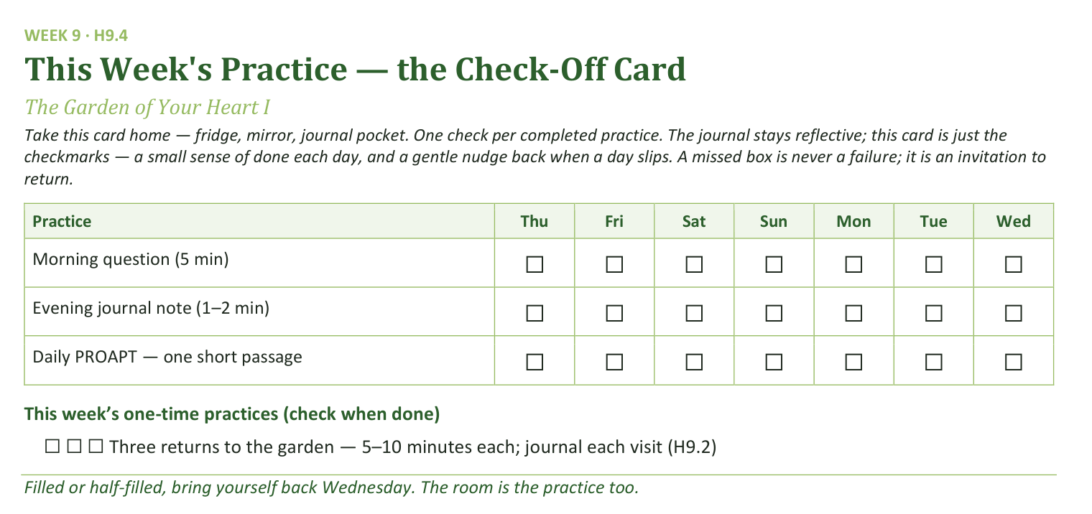
Your Take-Home Card — This Session’s Practice
Handed out now — fridge, mirror, journal pocket.
123
Notes:
S9 · 8:20–8:24 · LEAD: CONTENT PRESENTER
BEATS: 1. Card home: morning question, evening note, daily PROAPT — plus three garden returns as one-time checks. 2. Be honest with the room: this is the most demanding between-session week of the series. Two visits is fine. One is fine. The practice is the turning toward, not the metric.

Slide 12
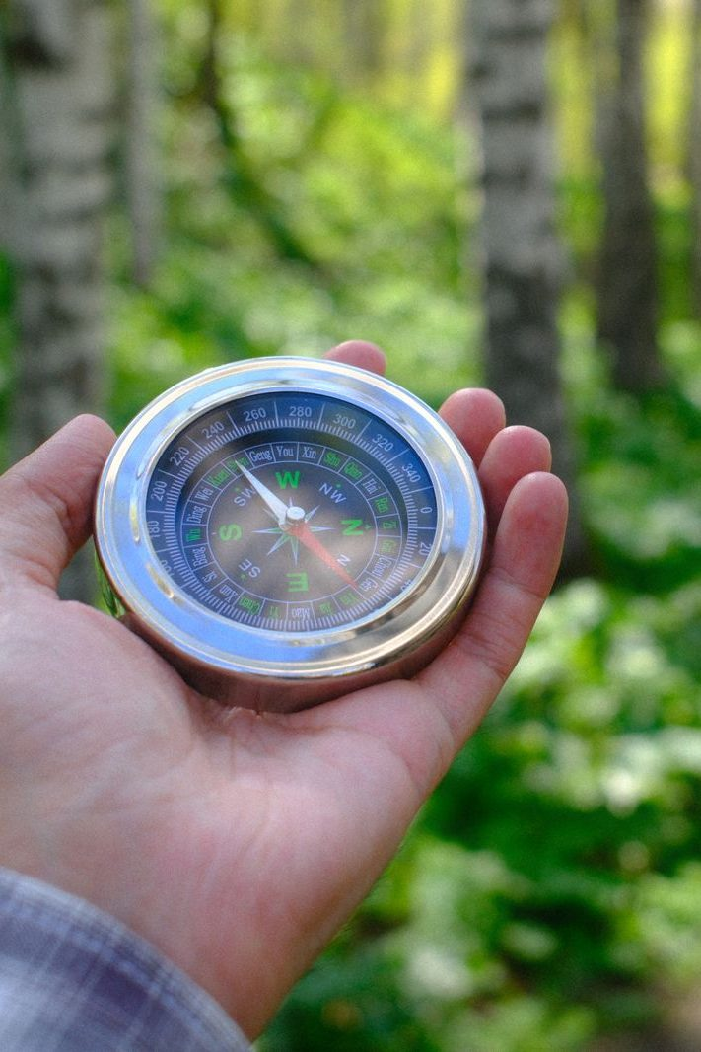
The Leader Feedback Round
• Two rounds, same as every session — the container holder first, then the content presenter: three things each
– “What I think went well tonight: ______”
– “What I’d do differently next time: ______”
– “If I were to teach tonight’s process to someone, I would tell them: ______”
• Then the room — the same two questions about tonight
• The leaders receive without defending — “thank you” is the whole response
124
Notes:
S9 · 8:24–8:28 · LEAD: BOTH LEADERS
BEATS: 1. Same round: leader's three answers first, then the room's two questions; 'thank you' is the whole response. 2. Today is the likeliest night of the series to DROP the round: if the room is still deep in the garden's quiet, five minutes of process talk can break what the Spirit is holding. Drop it, and say so at the debrief.

Slide 13
Closing the Container + Aaronic Blessing
• We close the way we opened — the container, six steps:
1 Stand again — same circle, same posture as the open
2 One-word landing — compare it to your opening word
3 The one thing you are taking from tonight
4 The one practice — committed aloud, or modified to one you will actually keep
5 Blessings — specific, witnessed, short
6 Closing prayer — and the Aaronic blessing, spoken over each other, face to face
THE AARONIC BLESSING — NUMBERS 6:24–26
“The Lord bless you and keep you;
the Lord make his face to shine upon you, and be gracious to you;
the Lord lift up his countenance upon you, and give you peace.”
125
Notes:
S9 · 8:28–8:30 · LEAD: CONTAINER HOLDER
BEATS: 1. 'What happened in your pair is yours. Carry it gently — don't debrief it on the way home unless your heart is fully ready.' 2. If something heavy surfaced, reach out — the team is walking with you. 3. Aaronic blessing; see you evenings.
CUES: Stay accessible for fifteen minutes after the close — today more than most, people will want to talk; the two-adult rule holds for any teen.

